Slide 1
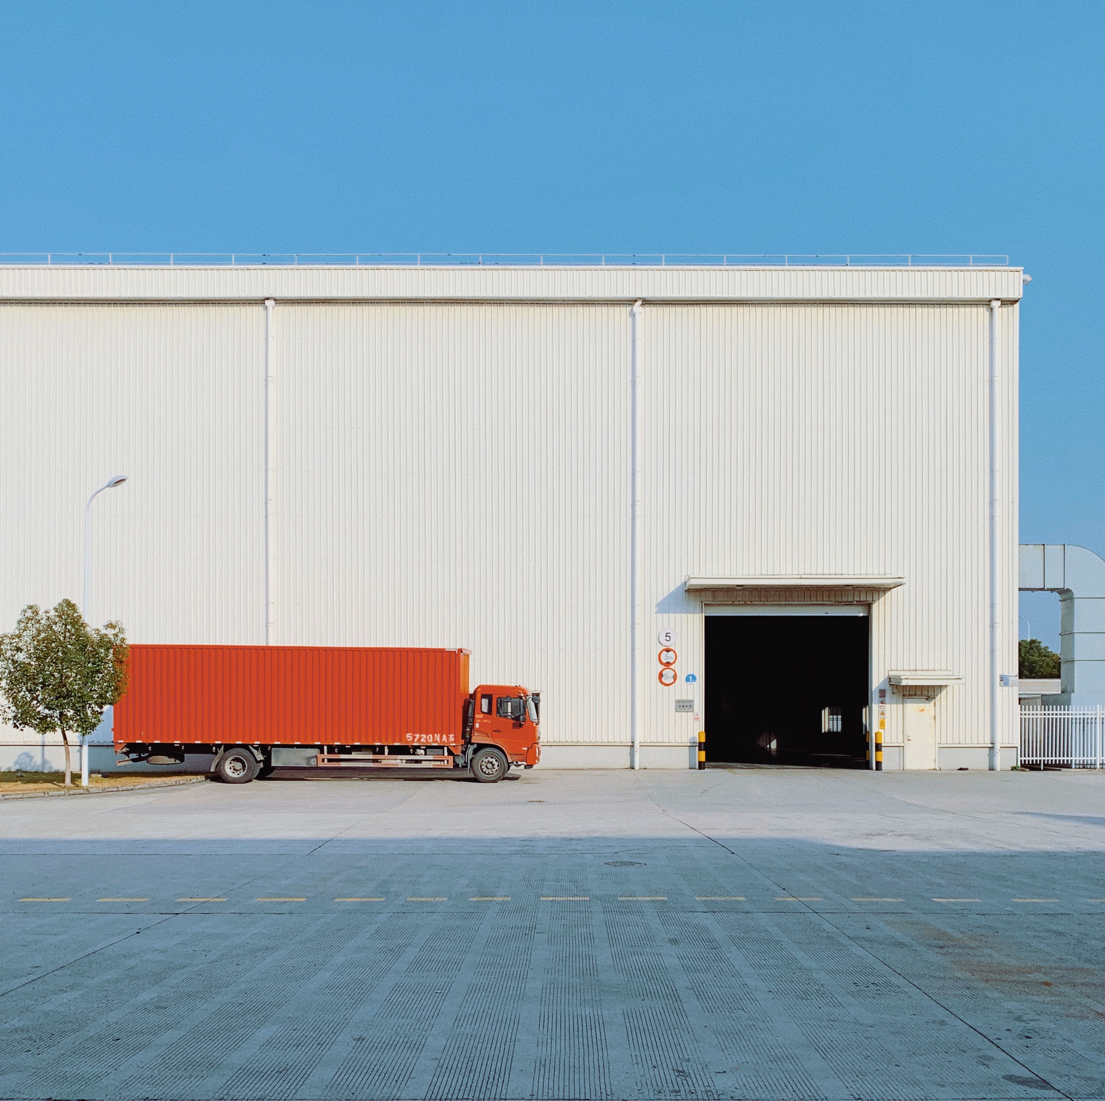
safepass
Pioneering safe overtaking with AI

Slide 2

Problem statement
The problem we address is the inherent challenge of overtaking slow-moving heavy vehicles, such as container trucks, on highways. This challenge primarily stems from the low field of vision caused by the truck in front.
The consequence of this challenge is that drivers frequently find themselves compelled to execute risky maneuvers in their attempts to overtake. These maneuvers, often performed without complete visibility, have led to a concerning number of accidents and near-miss incidents.
The limited field of vision, especially when following a towering container truck, poses a significant road safety challenge. Our mission is to address this issue by providing a comprehensive solution that ensures safer overtaking for all drivers on the road.
Accidents due to overtaking
Overtaking caused 25.7% of India’s 4.12 lakh road accidents in 2021.
25.7
%

Slide 3
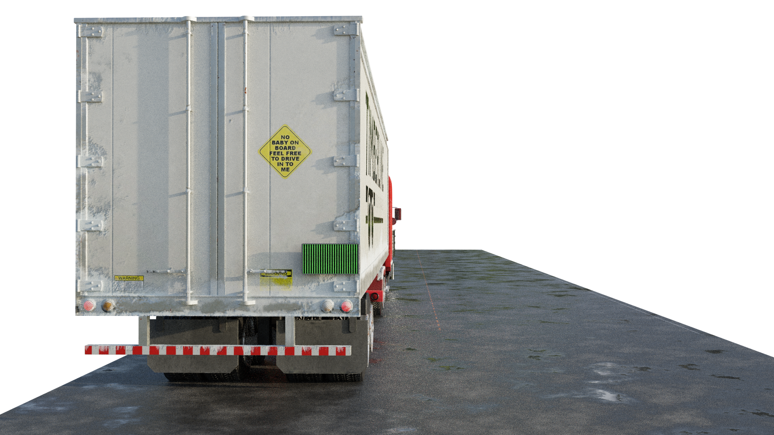
Project objective: Safe overtaking
This will enhance road safety by providing drivers with real-time guidance for safe overtaking on highways. The system ensures that when it's safe to overtake, a reassuring green light is displayed, signifying a clear path for the maneuver.
The light is green indicating that it is safe to overtake

Slide 4
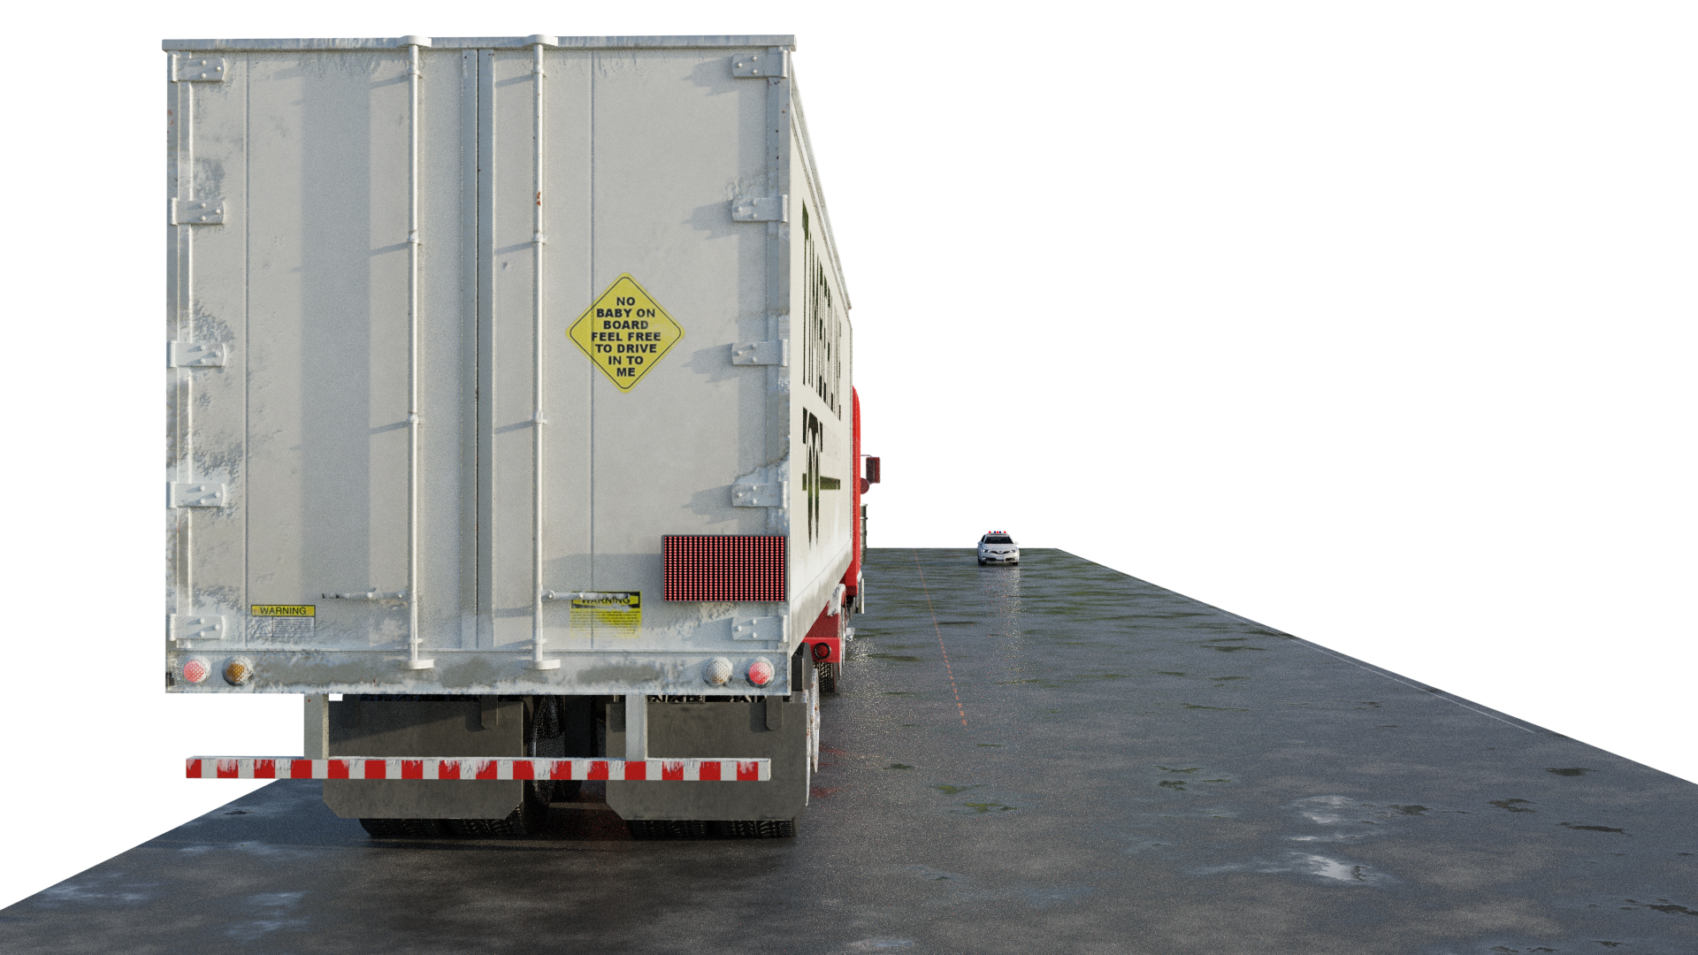
Project objective: Cautionary overtaking
Prevent risky overtaking maneuvers and accidents. Conversely, when an oncoming vehicle is detected or overtaking is unsafe, a cautionary red light is displayed, advising against overtaking.
The light is red indicating that there is a vehicle coming in the opposite direction.

Slide 5
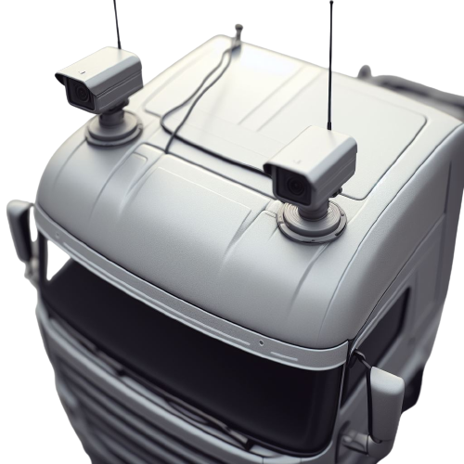
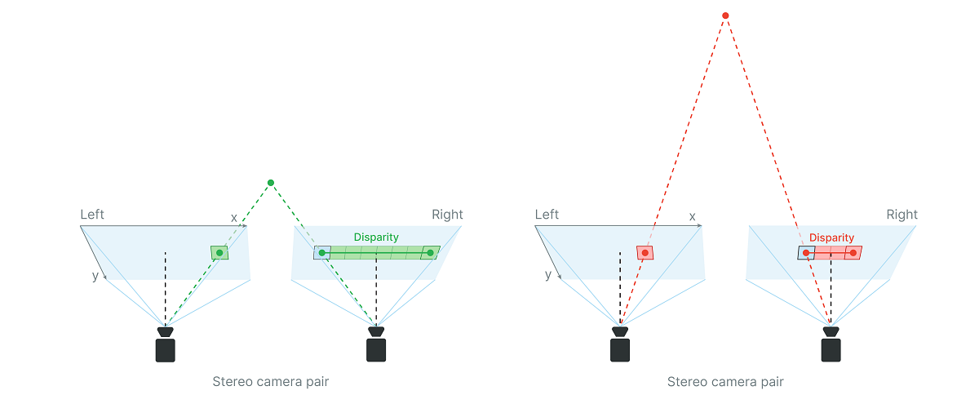
Depth estimation
This project employs a stereo depth vision system consisting of two cameras strategically mounted on top of the truck, one on each side. Stereo depth vision operates by calculating the disparity between two images captured from slightly different viewpoints. Disparity, in this context, denotes the variation in the distance between corresponding points in the left and right images of a stereo pair. This technique closely mimics the way our human eyes work. Just as our brains subconsciously gauge depth by comparing what our left eye sees to what our right eye sees, stereo vision utilizes these disparities to estimate the depth of objects and scenes accurately.

Slide 6
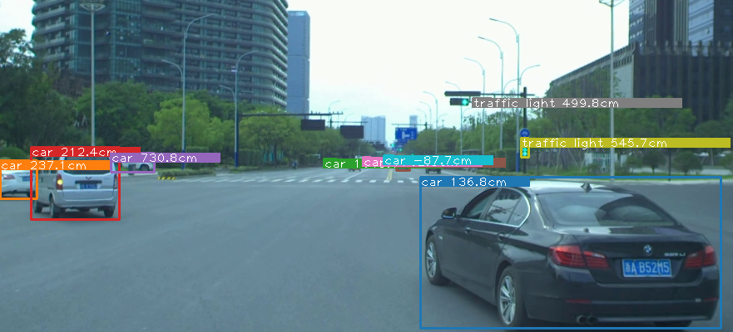
Realtime tracking

Slide 7
Realtime tracking
Object Tracking: In addition to depth estimation, the system continuously tracks objects, ensuring a comprehensive understanding of the road environment and the behavior of surrounding vehicles.
Speed Measurement: Our system also calculates the speed of tracked objects, contributing to a dynamic assessment of the overtaking scenario.
Dynamic Overtaking Opportunities: In real-time, the system identifies and communicates safe overtaking opportunities, taking into account not only the depth of objects but also their speed, trajectory, and the presence of oncoming traffic.
Model used for detection: Mask R-CNN is used, which excels at instance segmentation, offering precise segmentation.

Slide 8
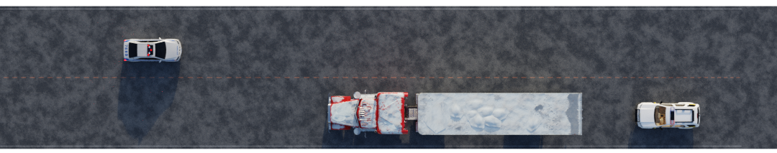
Signalling
Collision Avoidance Logic: Our system incorporates collision avoidance logic to predict and prevent overtaking risks, issuing real-time alerts for driver safety. This will actively anticipates scenarios where overtaking may pose a risk.
Dynamic Signaling: The system communicates with a display unit on the leading vehicle, illuminating green for safe overtaking and red for caution.

Slide 9
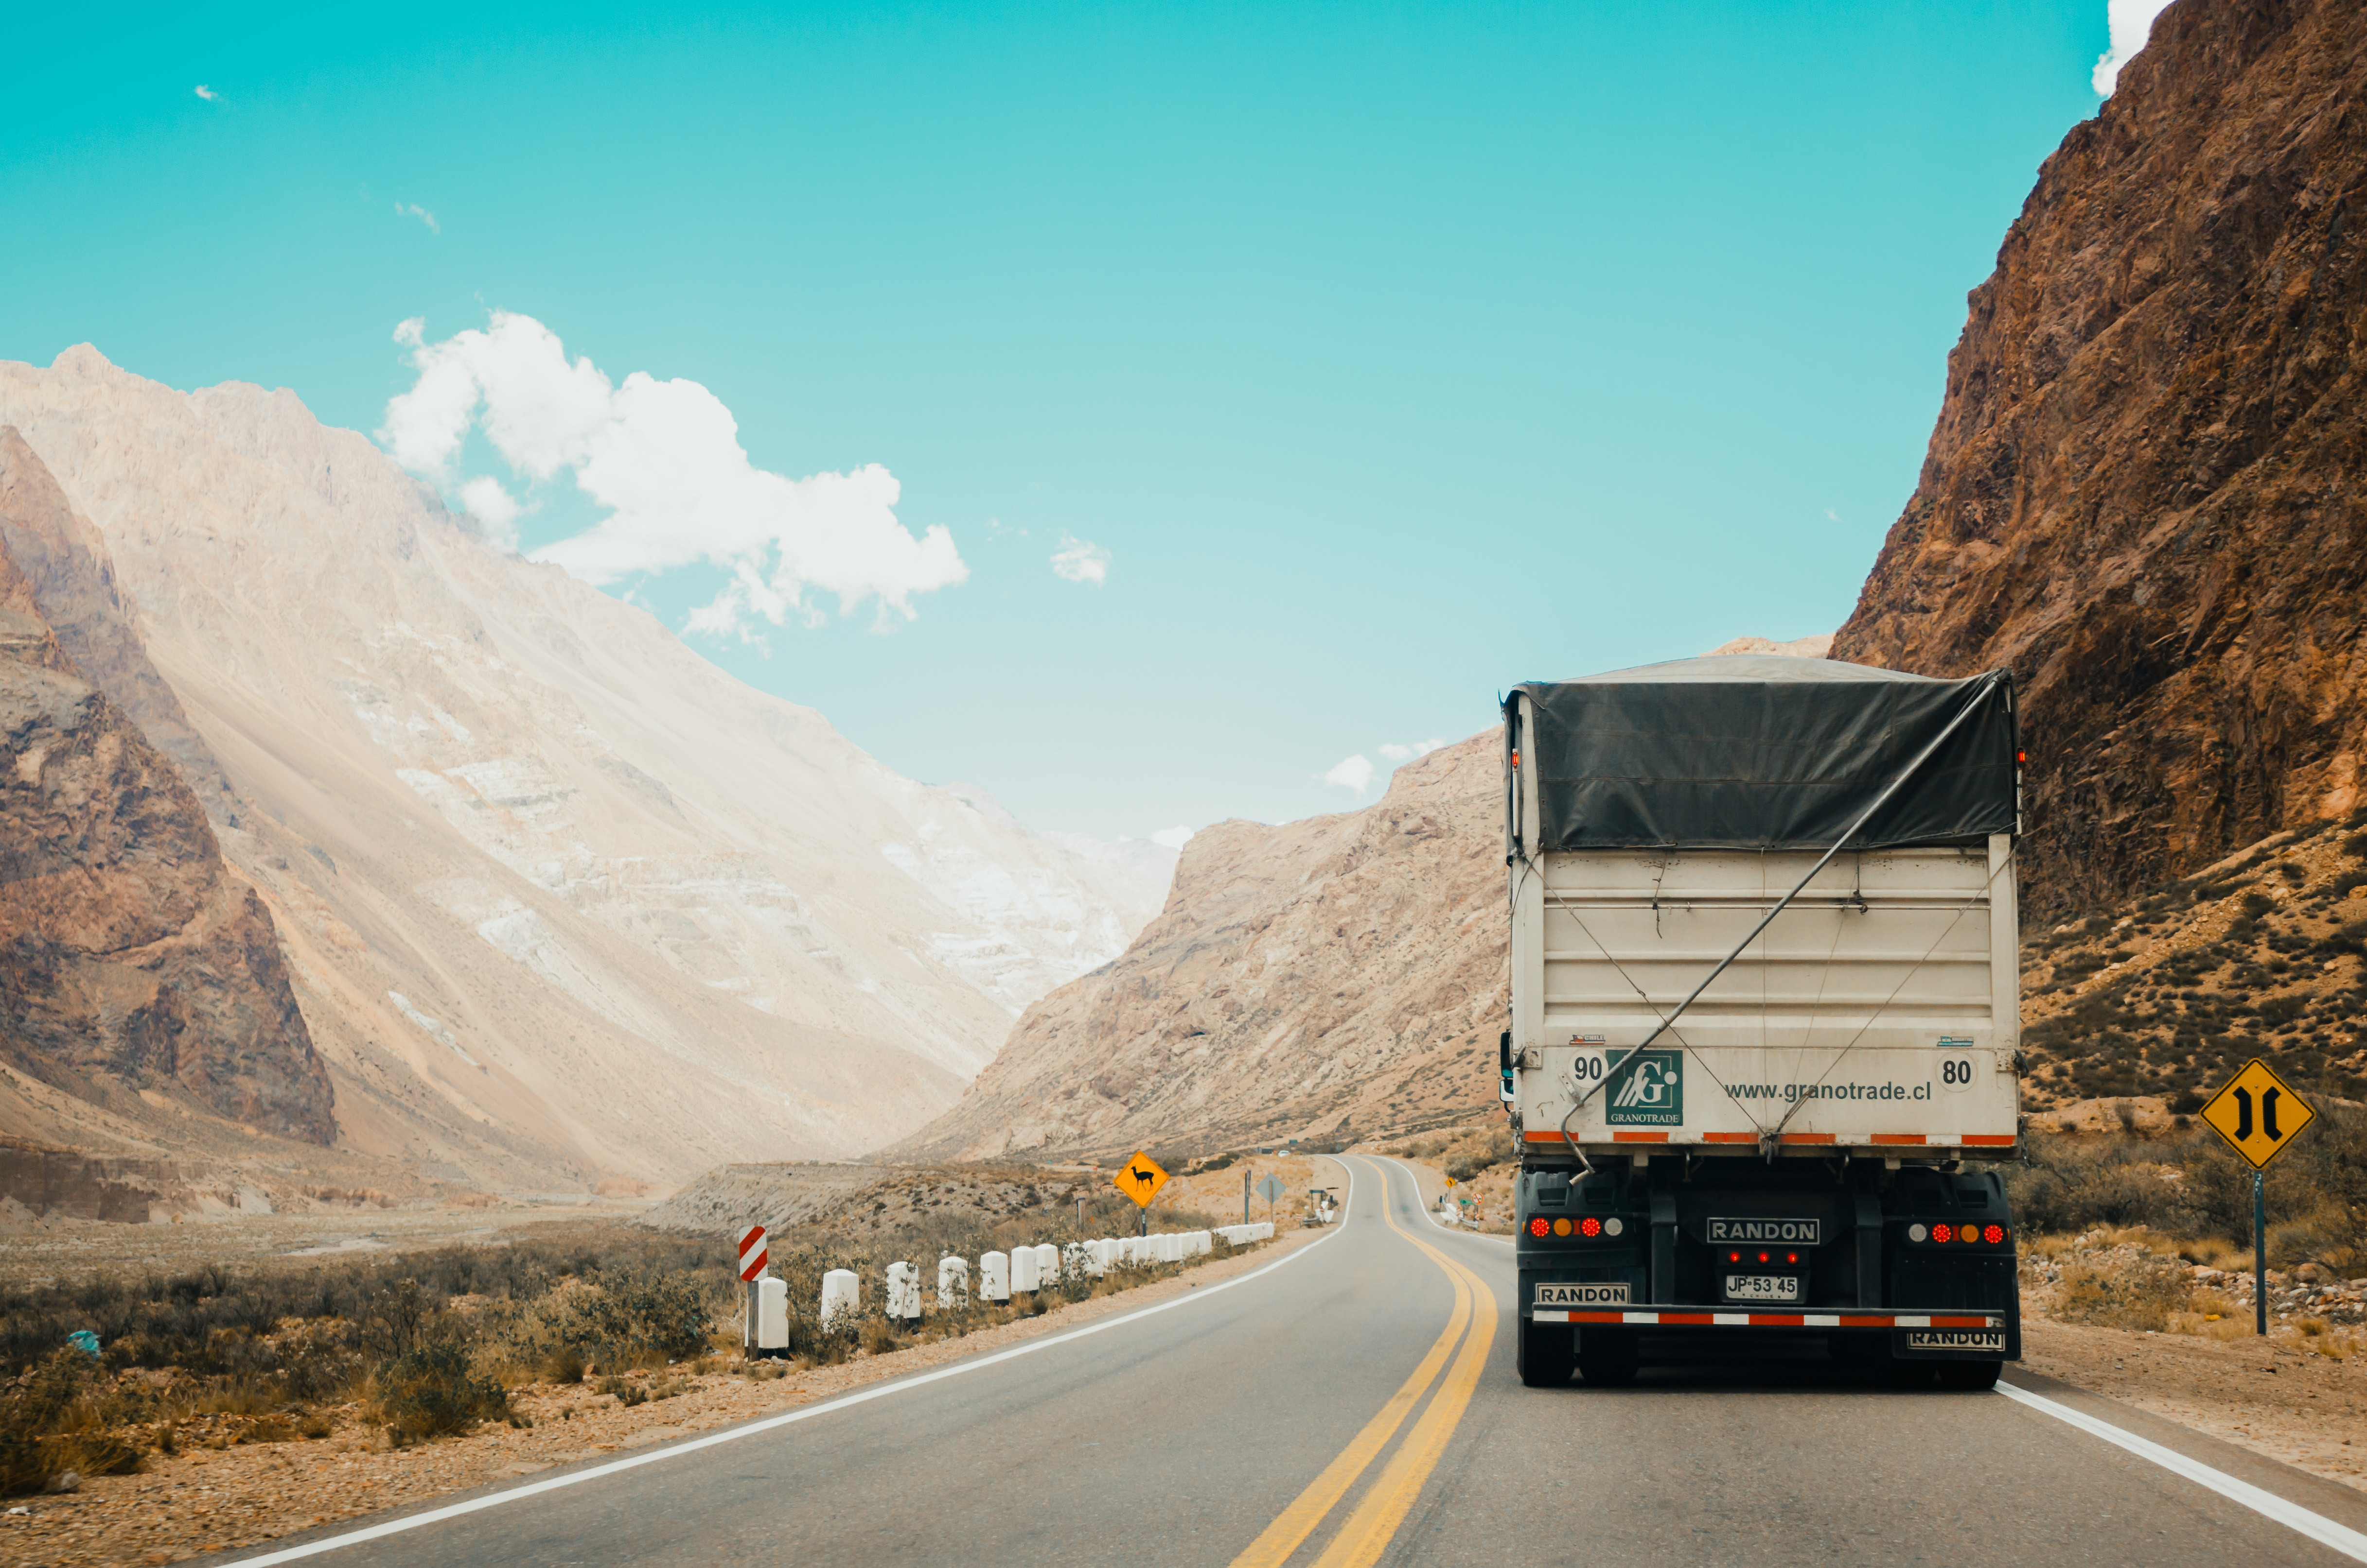
Thank you

